Slide 1


Slide 2

Adding workflow approval to Salt

Slide 3





Cleber Paiva de Souza
DIRECTOR
SSYS Sistemas
@cleberps
linkedin.com/in/cleberps
Lucas Sanches
SOFTWARE ENGINEER
SSYS Sistemas
linkedin.com/in/lucascosanches
Notes:
OPTION 2

Slide 4



Problem
No workflow approval in the Salt Project. It is a requirement for many business customers.
No persistency. Past actions are not reapplied if the system is reinstalled.
Simple actions require human intervention, such as rebooting, restarting services, installing packages, and many more.
Notes:
Dark mode

Slide 5
Workflow approval
BUSINESS REQUIREMENT
Chain of approval for mapped service request types.
Async actions with intermediate database to export pillar data.
Custom workflow for each type of service request.
Notes:
Dark mode

Slide 6
No persistency
COMPLIANCE
Salt does not keep historic data for further consumption, so our approach was to make usage of an intermediate database to export pillar data to the environment.
Situations such as system reinstallation will return machines to the latest known configuration based on pillar data.
Notes:
Dark mode

Slide 7
Personnel
OPERATIONS
Operators do not need to be in charge of mapped and repetitive tasks in the infrastructure.
Optimization of operators’ time for more skillful demands of the business.
Reduces the problem of contracting more IT professionals to the company for simple tasks.
Notes:
Dark mode

Slide 8







ITSM (Information technology service management)
Tools that connect business processes to IT demands.
Each one has its own key points and specific methods for extending and integrating it. Select your preferred tool.
Our work is based on Jira, but we have also experimented with ServiceNow.
Notes:
Dark mode

Slide 9



Technologies used
Salt
https://saltproject.io
https://github.com/saltstack/pepper
Jira
https://atlassian.com/software/jira
https://github.com/pycontribs/jira
Python
https://python.org
Flask
https://flask.palletsprojects.com
Notes:
Dark mode

Slide 10




Technologies used
Docker
https://docker.com
PostgreSQL
https://postgresql.org
https://psycopg.org
Gunicorn
https://gunicorn.org
Supervisor
https://supervisord.org
Code available on GitHub
https://github.com/s-sys/saltconf21
Notes:
Dark mode

Slide 11
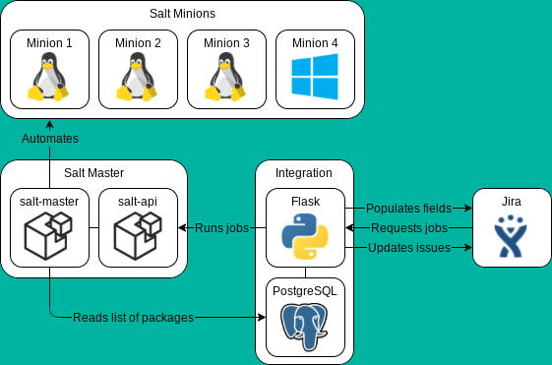
Solution architecture
HOW IT WORKS
Integration requests list of packages and minions from Salt.
Integration stores the data into the database and populates fields on Jira.
Jira requests reboots or package management from the integration.
Integration stores the data into the database and runs the appropriate jobs on Salt.
Integration updates the issue status on Jira.
Notes:
Dark mode

Slide 12
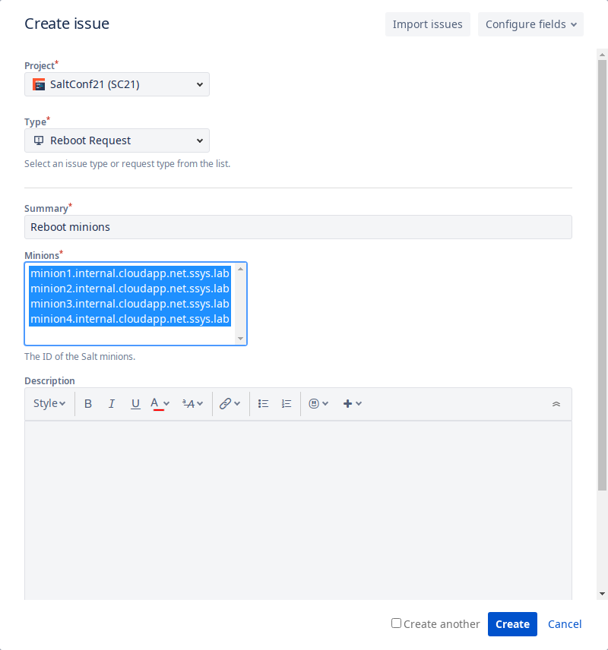
Jira service requests
REBOOT
Runs immediately after approval.
Notes:
Dark mode

Slide 13
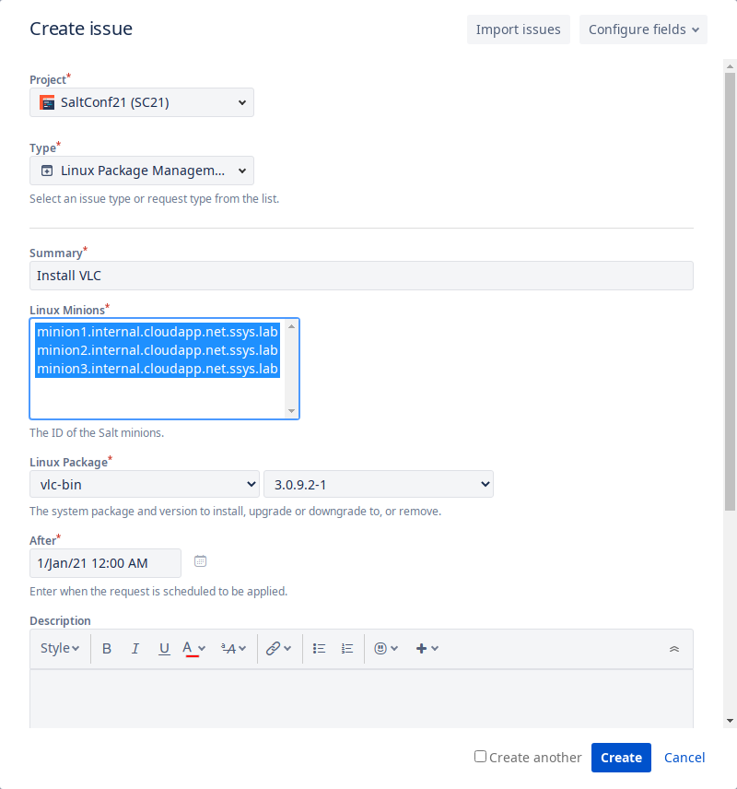
Jira service requests
LINUX PACKAGE MANAGEMENT
Packages can be removed.
Can be scheduled after a specified date and time.
Installation could be reverted.
Uses pkg.installed and pkg.purged.
Notes:
Dark mode

Slide 14
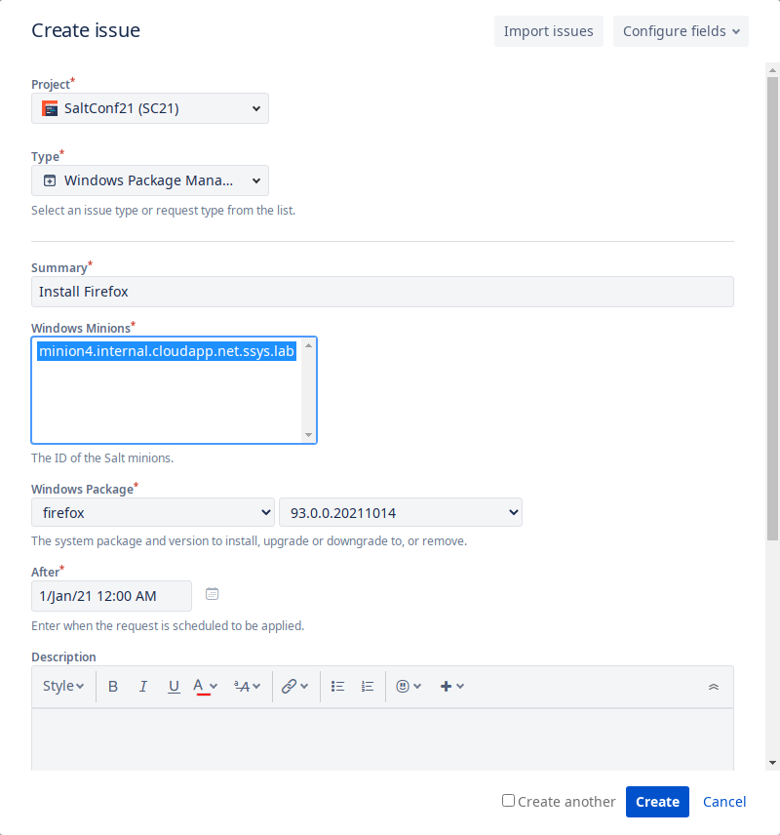
Jira service requests
WINDOWS PACKAGE MANAGEMENT
Packages can be removed.
Can be scheduled after a specified. date and time
Can be reverted.
Uses Chocolatey.
Notes:
Dark mode

Slide 15

Demo
LET'S SEE IT WORKING
Notes:
Dark mode

Slide 16

Limitations
WHAT WE COULDN'T DO
Jira can only store 10,000 field options.
Jira can't populate field options on-the-fly.
We can't separate packages per minion with Jira.
Other ITSM tools can solve those issues, but have their own limitations.
Notes:
Dark mode

Slide 17

Future work
WHAT COULD BE IMPROVED
Make it more robust for usage in production.
Use patches instead of deleting all options when populating Jira.
Allow reboots to be scheduled.
Allow packages to be reverted to a clean state.
Validate job results before updating tickets.
Notes:
Dark mode

Slide 18
Thank you
Cleber Paiva de Souza
cleber@ssys.com.br
Lucas Sanches
lucas.sanches@ssys.com.br
https://github.com/s-sys/saltconf21
Notes:
Dark mode

